Slide 1
Practical Project Demo
Creating Dynamic Rich-Data ASP.NET Web Application: Step-by-Step Live Demo
Svetlin Nakov
Telerik Corporation
www.telerik.com

Slide 2
Table of Contents
Sample practical project
Creating a simple blog system
Steps:
Prototyping of the user interface
Design of the database
Data access layer based on LINQ-to-SQL
User interface based on ASP.NET Web Forms
Testing the system

Slide 3
Assignment – Blog System
Create a simple blog system:
Read blog posts (messages) and comments
Login / logout
Post new message (for logged users)
Post comments for a message
Each blog message (post) has:
Author, date, subject, body
Comments have
Author date and body

Slide 4
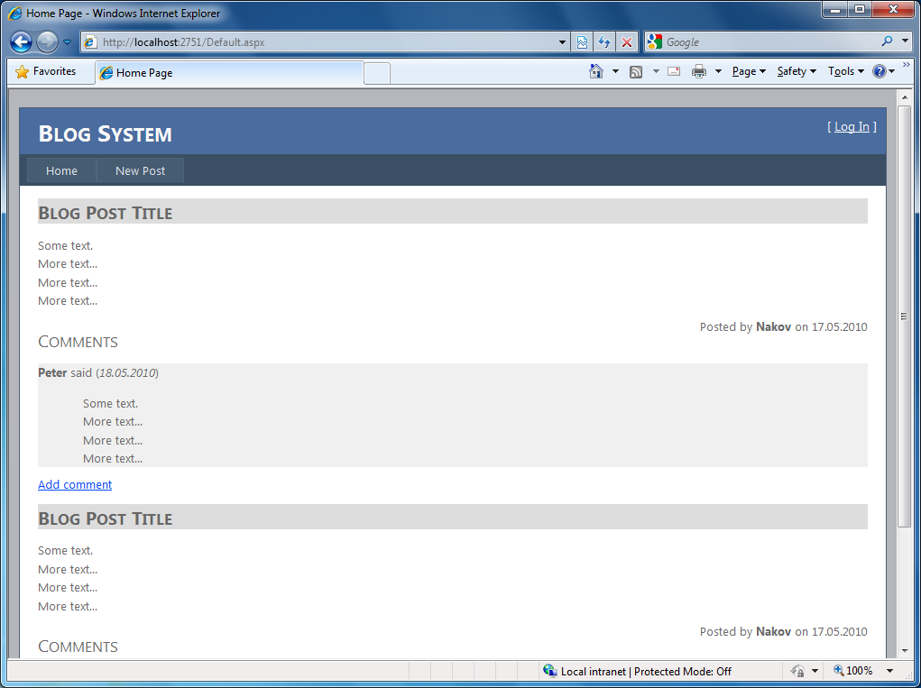
Step 1: Prototyping the UI (1)

Slide 5
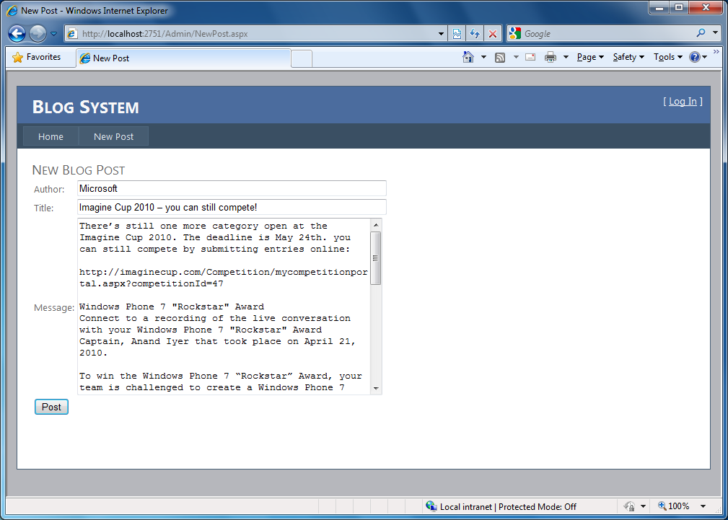
Step 1: Prototyping the UI (2)

Slide 6
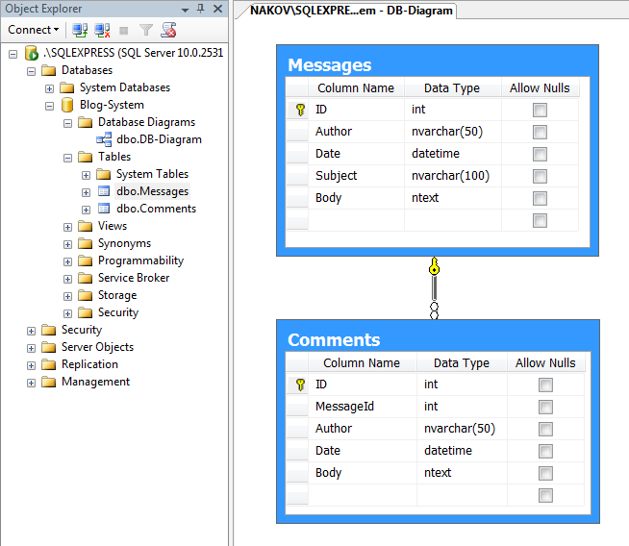
Design the Database

Slide 7
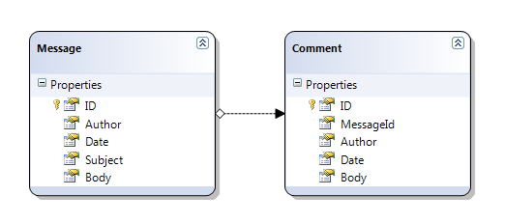
Create the Data Access Layer: based on LINQ-to-SQL

Slide 8
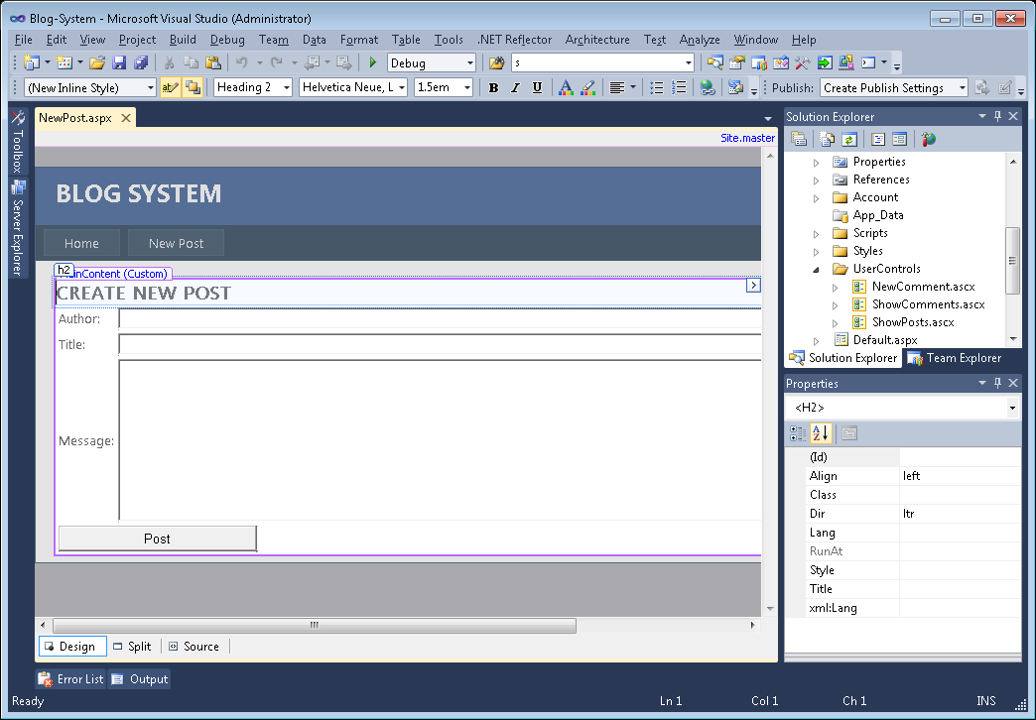
ASP.NET Web Forms UI

Slide 9
Testing the System
What happens when no posts are available in the system?
What happens when no comment are entered for given post?
What happens when the posts are too much (e.g. 500)?
How "create post" behaves with an empty form?
What happens if in a field of size 50 characters we enter 100 characters?

Slide 10
Practical Project Demo

